Slide 1

Data Visualization for Real Time and Historical GPS Data
Created by
Group - 12

Slide 2
Group Members
Swetha Natarajan – 0828972
Prasanna Venkatesh Jawahar – 0821988
Sriprithvirajan Annadurai – 0794007
Mohamed Fiazul Hasan Raja Abdul Rahman – 0821989
Rajat Rawat - 0816530

Slide 3
Background & Motivation
Drivool Technologies focuses on leveraging advanced tech for improved transportation experiences.The primary objective is to offer users actionable insights from GPS data for better decision-making.The company employs cutting-edge data processing techniques for real-time and historical GPS data analysis.Dynamic visuals are created, providing live updates and insights into past trends.Advanced technology ensures access to accurate and up-to-date information.Both real-time and historical GPS data are collected and transformed into clear visuals.Users can interact with these visuals to derive benefits for decision support in transportation.
The project highlights user interaction with visuals for maximum benefit. Drivool Technologies creates user-friendly interfaces for seamless data interaction, empowering users to customize their experience and extract relevant insights for decision-making.The project's motivation lies in optimizing vehicle performance through battery life prediction. Drivool aims to revolutionize this by employing advanced analytics and machine learning to provide accurate insights. This enables informed decisions, maximizing vehicle efficiency in the transportation industry.

Slide 4
Dataset Overview
• Source Name: Drivool Technologies Private Limited
• Data Collection Method: Real-time and historical data collection through IoT devices
• Size of the Dataset: The dataset size is continuously increasing as real-time data is collected, and historical data is archived. But for this Project we have taken one month data of the user.
• Type of Data: The data consists of GPS data related to vehicle tracking, including location, speed, and other relevant information.
• File Format: The data is stored in structured databases and can be accessed via APIs for real-time data and in various data formats (CSV, JSON, etc.) for historical data.
Dataset Features:
This data consist of 8 variables such as Latitude, Longitude, Direction , Engine Status, GSM network strength, Speed, Timestamp and Battery Voltage.

Slide 5
Data Collection & Preprocessing
Data Gathering
Data Cleaning
Data Transformation
Data has been collected from Drivool Technology gives real time and historical GPS data for a user.
Inconsistencies in the dataset has been rectified and null values in Engine status have been filled accordingly.
Raw data such as timestamp has been converted to human readable data and other insights have been provided.

Slide 6
Problem Statement
Despite the wealth of GPS data available in today's digital age, there persists a notable challenge in fully capitalizing on its potential to offer actionable insights for decision-making across diverse domains. While the data itself is abundant, effectively harnessing it to derive meaningful conclusions and support informed decision-making processes remains a significant hurdle.
The primary objective of this project is to tackle this challenge head-on by developing a comprehensive solution for visualizing both real-time and historical GPS data. By doing so, the project aims to bridge the gap between raw data and actionable insights, ultimately empowering users to make informed decisions based on a deeper understanding of the information at hand.
At the core of this endeavor lies the goal of empowering users with intuitive, informative, and interactive visualizations derived from GPS data. These visualizations serve as powerful tools that enable users to grasp complex information quickly and effectively. By presenting data in a visually compelling manner, the project seeks to enhance users' ability to interpret and analyze information, thereby facilitating better decision-making processes.
By providing users with access to intuitive and informative visualizations, the project aims to enhance their ability to make informed decisions across various domains. Whether it's optimizing transportation routes, improving resource allocation, or enhancing operational efficiency, the insights gleaned from GPS data visualizations have the potential to drive significant improvements in decision-making processes.

Slide 7

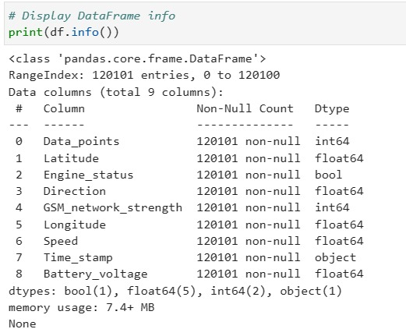
Feature Engineering
Identifying Features
Label Encoding
Engine Status is categorical variable, so we have labelled this to convert the Boolean values to integers.
Photos provided by Pexels

Slide 8

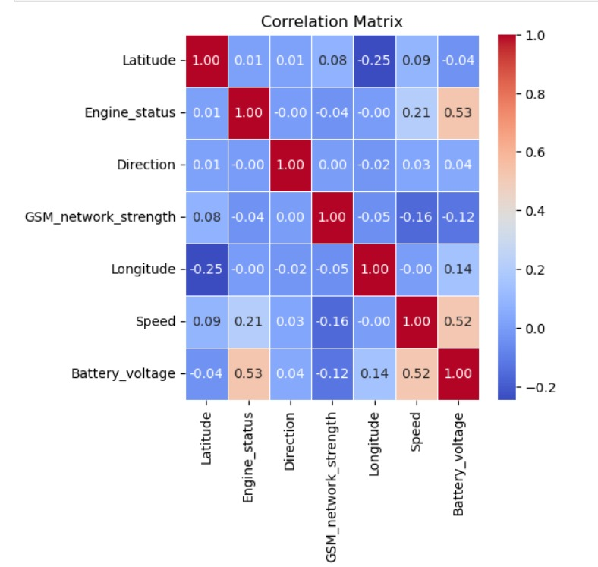
Predictive Analysis
Forecasting Insights
According to this correlation matrix, other than any other variables the correlation between the Engine status, Speed and Battery voltage is higher than the any other variables. With this we are ahead to predict the battery life of the vehicle by analysing the runtime and distance travelled throughout by the user.
Photos provided by Pexels

Slide 9
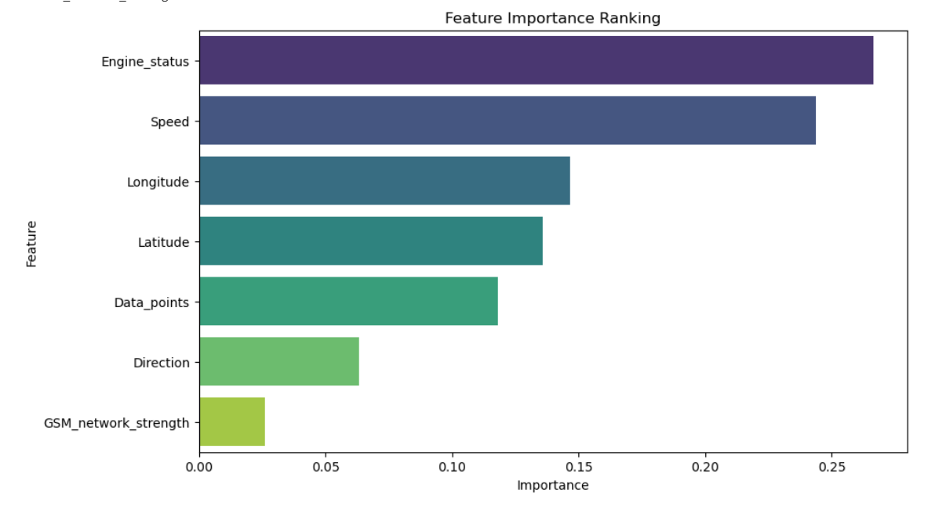
Feature Importance
In this after considering Battery voltage as target variable, we can identify the Engine Status and Speed have the higher ranking in the Feature Importance.

Slide 10
Model Training
Decision Tree Regressor Model
Linear Regression Model
The MSE for the Decision Tree Regressor model is 0.00010182656695282748, which is slightly higher than that of the Linear Regression model and significantly higher than that of the Random Forest Regressor model.
R-Squared value for Decision Tree Regressor model is 0.3346363737928908, which is lower than that of both the Linear Regression and Random Forest Regressor models.
The MSE for the Linear Regression model is 8.01632056327801e-05 (0.0000801632056327801), which is relatively low.
R-Squared value for Linear Regression model is 0.4761909118185029. While this is not bad, it's not particularly high either.
Random Forest Regressor Model
The MSE for the Random Forest Regressor model is 4.805063383199276e-05 (0.00004805063383199276), which is lower than that of the Linear Regression model, indicating that the Random Forest Regressor model's predictions are closer to the actual values on average. The R-squared score for the Random Forest Regressor model is 0.6860235503882227, which is significantly higher than that of the Linear Regression model, suggesting a better fit of the model to the data.
Photos provided by Pexels

Slide 11
Conclusion
Key Findings
Future Applications
Overall Impact
As mentioned in the correlation matrix the battery voltage is the target variable.
The lifetime of the battery is predicted according to the voltage level for the future to predict the time period left for the battery in the usage.
By this insights the Drivool Technology can be responsible for either notify or install a battery health notifier according to the usage.

